Slide 1
The Scientific Revolution
1500-1800
16th & 17th Century

Slide 2
I can…
Describe how the Scientific Revolution’s impact on religious, political and cultural institutions challenged how people viewed the world.

Slide 4
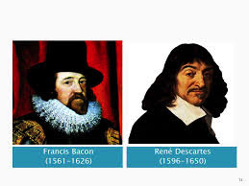
New Theories of Universe
Greeks explain nature by observing rather than experimenting. (Ex: Ptolemy)
Sir Francis Bacon & Rene Descartes develop scientific method.
https://www.youtube.com/watch?v=0A6UKoMcE10
Notes:
Ptolemy (pronunciation: Tolemy) believed that the earth was round and unmoving ball. Based on common sense earth did no seem to move.
Bacon: scientist, juror, philosopher Descartes: mathematician/ “I think therefore I am” (we can only be certain of 2 things.. I think and I am)
Scientific Method: First on doubts; then one finds truth based on logical thinking and experiment.

Slide 5
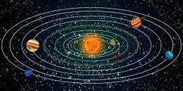
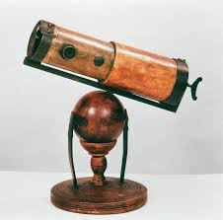
Questioning Old Beliefs
Nicolaus Copernicus: heliocentric system
Brahe & Kepler: improves Copernican theory and first to openly accept.
Galileo: telescope – modern physics – question at inquisition by Catholic church.
Newton: improved telescope – three main laws of motion
Notes:
1473-1543: died before Decartes and Bacon were born – believed sun center of solar system (upset Catholic b/c supported Ptolemy)
Never accepted copernicus’s helocentric thesis but realized importance of data collection –
Brahe: astronomer (three laws of planetary motion – ended Greek astronomy);
Kepler (1571-1630) first to openly accept Copernicus’s theory
Galileo: used telescope for proof; forms basis of modern physics- brilliant instrument maker – never published findings b/c fear – called to inquisition forced to agree with them but after whispers “But it does move!”
Newton: improves accuracy; brilliant scientist, professor of math in his 20s and developed calculus; three main laws of motion

Slide 6
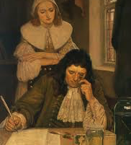
Scientists leads to new discoveries
Scientists study the human body.
Learn a great deal about disease
through use of microscope.
This type of thinking leads
“Age of Reason” or “Enlightenment”
Notes:
Open way to discovery of germ causing diseases – increase life expect./population

Slide 7
Outcomes
Creation of a new world view
Reason
Scientific Method and the laws of human society
Progress
Notes:
Scientific Revolution
Outcome
Creation of new world view
shaped the modern mind
scientific method; used to examine all aspects of life
Reason
nothing should be accepted on faith; everything should be subjected to rational, critical, scientific way of thinking
brought conflict with the church; question authority of the bible and the church
Scientific Method and the laws of human society
method to be used for human nature not just nature
social science was born
Progress
humans could create better society and better people
Expanded the secular view of the renaissance
concentrated on worldly explanations
intellectualism of enlightenment had a large impact on middle class and aristocracy
was resented by poor and peasants who were preoccupied with survival and didn’t like their traditional beliefs being challenged

Slide 8
Activity
Major advances in science are often controversial because they change our way of thinking. These advances also often raise important ethical questions and come into conflict with traditional religious values. Conflicts as explosive and troubling as those Copernicus and Galileo had with the Church.
Give 2 examples of scientific advances that have raised such controversy today.

